Slide 1
Database Management System

Slide 2
Contents
Database Design
Codd’s Rule
Relational Algebra

Slide 3
Database Design
UoD
Req. Coll. And Analysis
Data Requirement
Conceptual Design
High level Conceptual Schema
Logical Design
Logical Schema
Physical Design
Internal Schema

Slide 4
Codd's rules
Codd's 12 rules are a set of thirteen rules (numbered zero to twelve) proposed by Edgar F. Codd, a pioneer of the relational model for databases, designed to define what is required from a database management system in order for it to be considered relational, i.e., a relational database management system RDBMS

Slide 5
Rule 0: Foundation Rule
The system must qualify as relational, as a database, and as a management system.
For a system to qualify as a relational database management system ( RDBMS), that system must use its relational facilities (exclusively) to manage the database.

Slide 6
Rule 1: The information rule:
All information in the database is to be represented in one and only one way, namely by values in column positions within rows of tables.

Slide 7
Rule 2: The guaranteed access rule :
All data must be accessible. This is essentially a restatement of the fundamental requirement for primary keys. It says that every individual scalar value in the database must be logically addressable by specifying the name of the containing table, the name of the containing column and the primary key value of the containing row.

Slide 8
Rule 3: Systematic treatment of null values:
The DBMS must allow each field to remain null (or empty). Specifically, it must support a representation of "missing information and inapplicable information" that is systematic, distinct from all regular values (for example, "distinct from zero or any other number", in the case of numeric values), and independent of data type. It is also implied that such representations must be manipulated by the DBMS in a systematic way.

Slide 9
Rule 4: Active online catalog based on the relational model:
The system must support an online, inline, relational catalog that is accessible to authorized users by means of their regular query language. That is, users must be able to access the database's structure (catalog) using the same query language that they use to access the database's data.

Slide 10
Rule 5: The comprehensive data sublanguage rule:
The system must support at least one relational language that
Has a linear syntax
Can be used both interactively and within application programs,
Supports data definition operations (including view definitions), data manipulation operations (update as well as retrieval), security and integrity constraints, and transaction management operations (begin, commit, and rollback).

Slide 11
Rule 6: The view updating rule:
All views that are theoretically updatable must be updatable by the system.

Slide 12
Rule 7: High-level insert, update, and delete:
The system must support set-at-a-time insert, update, and delete operators. This means that data can be retrieved from a relational database in sets constructed of data from multiple rows and/or multiple tables. This rule states that insert, update, and delete operations should be supported for any retrievable set rather than just for a single row in a single table.

Slide 13
Rule 8: Physical data independence:
Changes to the physical level (how the data is stored, whether in arrays or linked lists etc.) must not require a change to an application based on the structure.

Slide 14
Rule 9: Logical data independence: Changes to the logical level (tables, columns, rows, and so on) must not require a change to an application based on the structure. Logical data independence is more difficult to achieve than physical data independence.

Slide 15
Rule 10: Integrity independence:
Integrity constraints must be specified separately from application programs and stored in the catalog. It must be possible to change such constraints as and when appropriate without unnecessarily affecting existing applications.

Slide 16
Rule 11: Distribution independence:
The distribution of portions of the database to various locations should be invisible to users of the database. Existing applications should continue to operate successfully :
when a distributed version of the DBMS is first introduced; and
when existing distributed data are redistributed around the system.

Slide 17
Rule 12: The nonsubversion rule:
If the system provides a low-level (record-at-a-time) interface, then that interface cannot be used to subvert the system, for example, bypassing a relational security or integrity constraint.

Slide 18
Relational Algebra
Relational algebra and relational calculus are formal languages associated with the relational model.
Informally, relational algebra is a (high-level) procedural language and relational calculus is a non-procedural language.
However, formally both are equivalent to one another.
A language that produces a relation that can be derived using relational calculus is relationally complete.

Slide 19
Relational Algebra
Relational algebra operations work on one or more relations to define another relation without changing the original relations.
Both operands and results are relations, so output from one operation can become input to another operation.
Allows expressions to be nested, just as in arithmetic. This property is called closure.

Slide 20
Relational Algebra
Five basic operations in relational algebra: Selection, Projection, Cartesian product, Union, and Set Difference.
These perform most of the data retrieval operations needed.
Also have Join, Intersection, and Division operations, which can be expressed in terms of 5 basic operations.

Slide 21
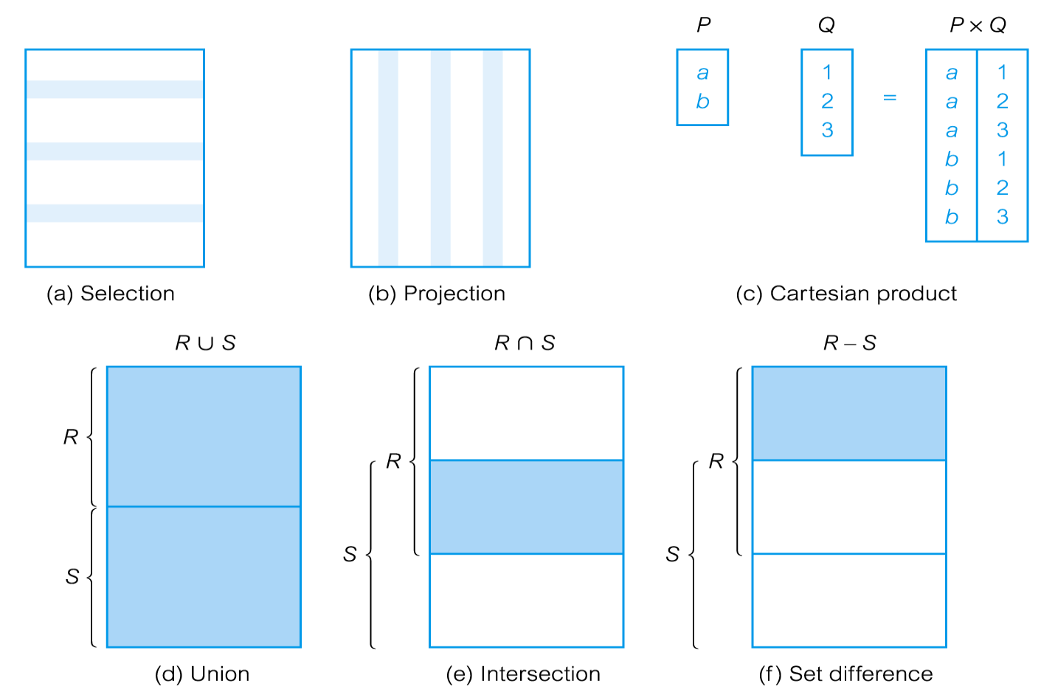
Relational Algebra Operations

Slide 22
Selection
σ predicate (R)
Works on a single relation R and defines a relation that contains only those tuples (rows) of R that satisfy the specified condition (predicate).
RA: σc (R)
Select * from R where C;

Slide 23
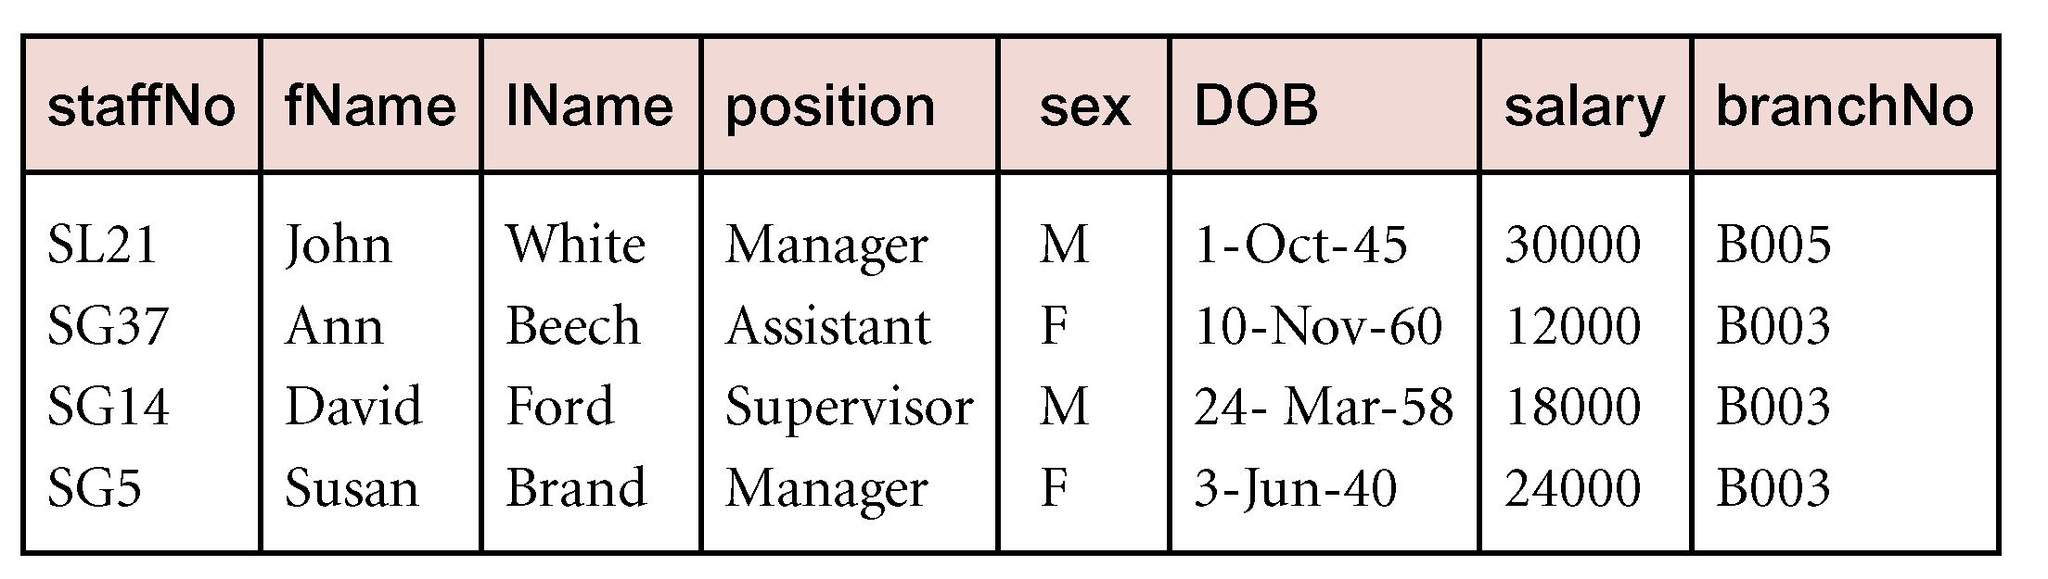
Example - Selection
List all staff with a salary greater than £10,000.
σ_{salary > 10000} (Staff)

Slide 24
Student
RN | Name | CGPA
1 | A | 8.2
2 | B | 7.3
3 | C | 5.0
4 | A | 6.8
5 | D | 9.2
σc2 (σc1 (R)) = σc1 (σc2 (R))
σRN>2 (σCGPA>=7.4 (Student)) = σCGPA>=7.4 (σRN>2 (Student))

Slide 25
Projection
Π col1, . . . , coln(R)
Works on a single relation R and defines a relation that contains a vertical subset of R, extracting the values of specified attributes and eliminating duplicates.

Slide 26
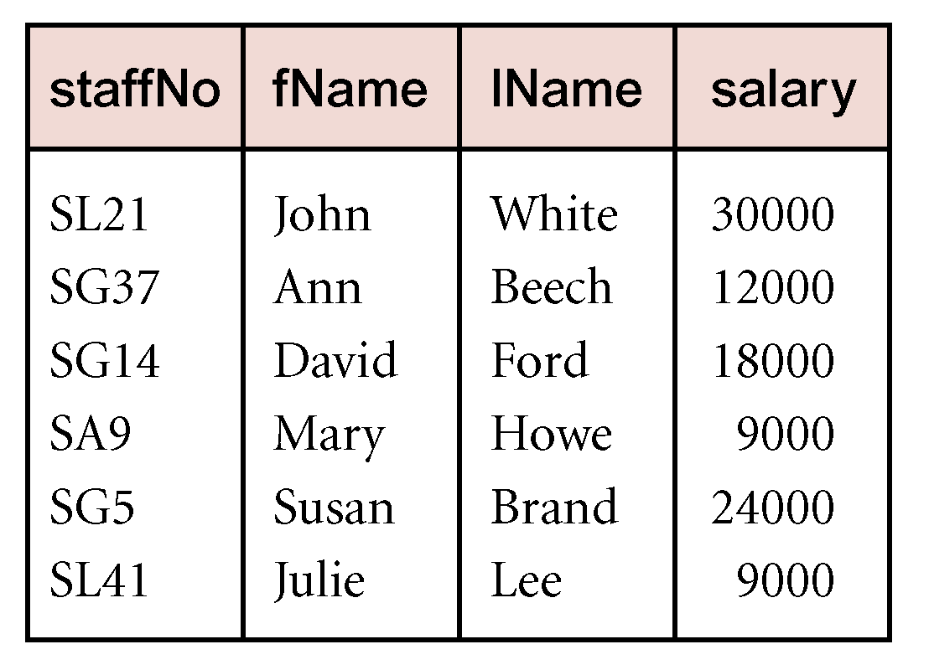
Example - Projection
Produce a list of salaries for all staff, showing only staffNo, fName, lName, and salary details.
ΠstaffNo, fName, lName, salary(Staff)

Slide 27
Student
RN | Name | CGPA
1 | A | 8.2
2 | B | 7.3
3 | C | 5.0
4 | A | 6.8
5 | D | 9.2
Find the name of students whose CGPA is more than 6.
Πname[σCGPA>6(Student)]

Slide 28
RENAME
The general RENAME operation ρ can be expressed by any of the following forms:
ρ _{S}(R) changes:
the relation name only to S
ρ_{(B1, B2, …, Bn )}(R) changes:
the column (attribute) names only to B1, B2,
…..Bn
ρ _{S (B1, B2, …, Bn )}(R) changes both:
the relation name to S, and
the column (attribute) names to B1, B2, …..Bn

Slide 29
Renaming Example
Employee
Name
SSN
John
999999999
Tony
777777777
_{LastName, SocSecNo} (Employee)
LastName
SocSecNo
John
999999999
Tony
777777777

Slide 30
Union
R ∪ S
Union of two relations R and S defines a relation that contains all the tuples of R, or S, or both R and S, duplicate tuples being eliminated.
R and S must be union-compatible.
If R and S have I and J tuples, respectively, union is obtained by concatenating them into one relation with a maximum of (I + J) tuples.

Slide 31
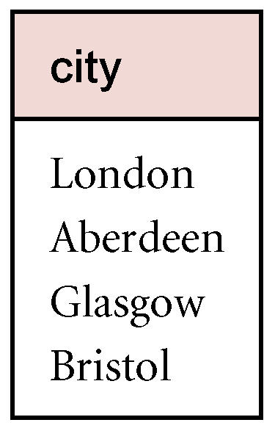
Example - Union
(select * from R) union (select * from S);
List all cities where there is either a branch office or a property for rent.
Π_{city}(Branch) ∪ Π_{city}(PropertyForRent)

Slide 32
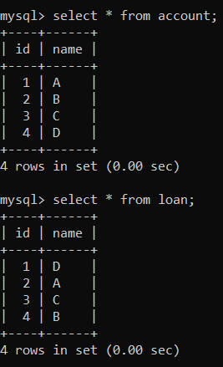
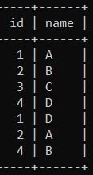
Q. Find out the customer who has either an account or loan or both.
(Select * from account) union (select * from loan);

Slide 33
Set Difference
R – S
Defines a relation consisting of the tuples that are in relation R, but not in S.
R and S must be union-compatible.

Slide 34
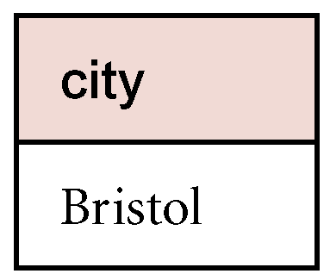
Example - Set Difference
List all cities where there is a branch office but no properties for rent.
Π_{city}(Branch) – Π_{city}(PropertyForRent)

Slide 35
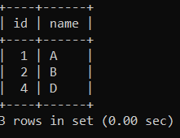
Q. Find out the customer who has an account but not taken the loan.
Select * from account where not exists (select * from loan where account.id = loan.id and account.name = loan.name);
Select * from account where(id,name) not in (select * from loan);

Slide 36
Intersection
R ∩ S
Defines a relation consisting of the set of all tuples that are in both R and S.
R and S must be union-compatible.
Expressed using basic operations:
R ∩ S = R – (R – S)

Slide 37
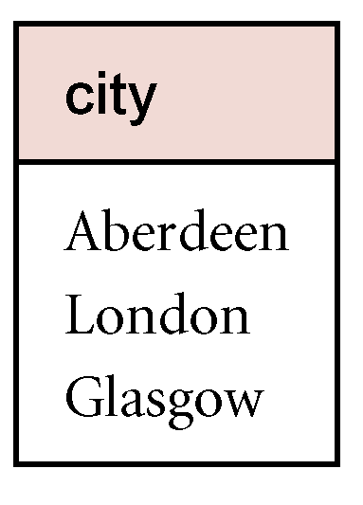
Example - Intersection
List all cities where there is both a branch office and at least one property for rent.
Π_{city}(Branch) ∩ Π_{city}(PropertyForRent)

Slide 38
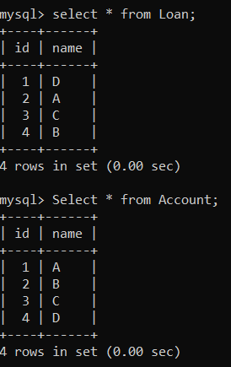
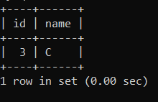
Q. Find out the customer who has both an account and has taken loan.
Select * from account where (id, name) in (select * from loan);
Select * from account where exists (select * from loan where account.id = loan.id and account.name = loan.name);

Slide 39
Cartesian product
R X S
Defines a relation that is the concatenation of every tuple of relation R with every tuple of relation S.
Select * from R,S;
Select * from R cross join S;
R1 R2 R1*R2
Attributes: a b a+b
Tuples : n1 n2 n1*n2

Slide 40
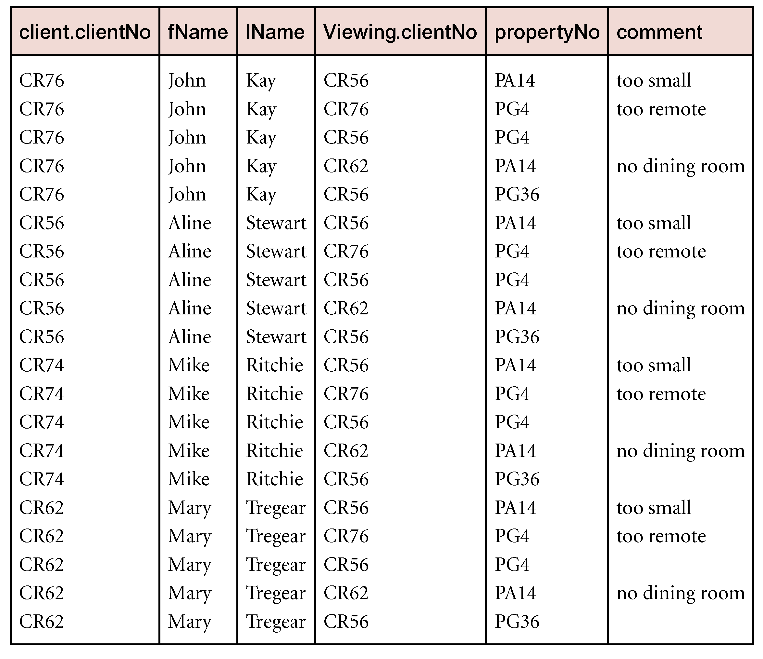
Example - Cartesian product
List the names and comments of all clients who have viewed a property for rent.
(Π_{clientNo, fName, lName}(Client)) X (Π_{clientNo, propertyNo, comment} (Viewing))

Slide 41
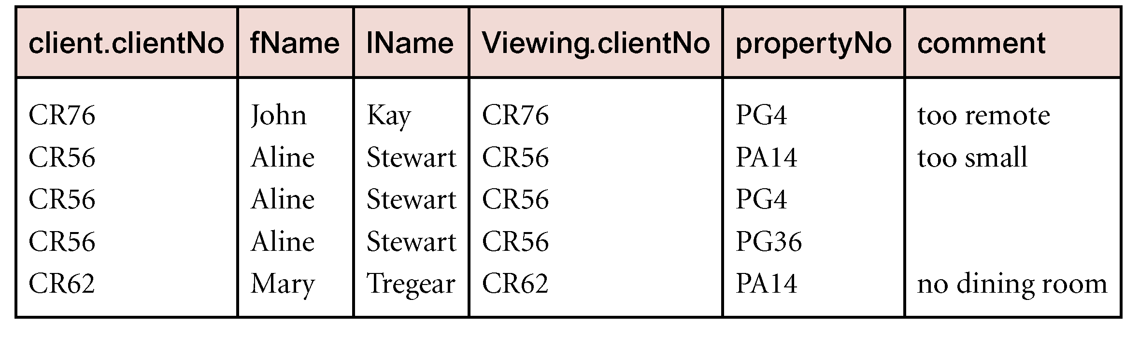
Example - Cartesian product and Selection
Use selection operation to extract those tuples where Client.clientNo = Viewing.clientNo.
σClient.clientNo = Viewing.clientNo((∏_{clientNo, fName, lName}(Client)) Χ
(∏_{clientNo, propertyNo, comment}(Viewing)))
Cartesian product and Selection can be reduced to a single operation called a Join.

Slide 42
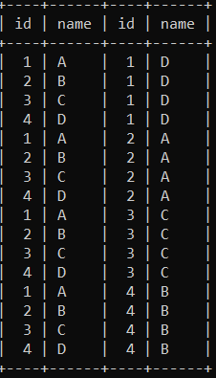
Select * from account, loan;
Select * from account, loan where account.id = loan.id;

Slide 43
Binary Relational Operations: JOIN
JOIN Operation (denoted by )
The sequence of CARTESIAN PRODECT followed by SELECT is used quite commonly to identify and select related tuples from two relations
A special operation, called JOIN combines this sequence into a single operation
This operation is very important for any relational database with more than a single relation, because it allows us combine related tuples from various relations
The general form of a join operation on two relations R(A1, A2, . . ., An) and S(B1, B2, . . ., Bm) is:
R _{<join condition>}S
where R and S can be any relations that result from general relational algebra expressions.

Slide 44
Join
Meaning: R S = Π_{A}(σ_{C}(R × S))
Where:
The selection σ_{C} checks equality of all common attributes.
The projection eliminates the duplicate common attributes.
select * from loan join account join customers where loan.id = account.id and loan.id=customers.id

Slide 45
Types of Join
Inner Join
Theta join
Equi join
Natural join
Outer Join
Left Outer join
Right Outer join
Full Outer join

Slide 46
Theta Join
A join that involves a predicate
R1 _{θ} R2 = σ _{θ} (R1 × R2)
Here θ can be any condition

Slide 47
Equi-join
A theta join where θ is an equality
R1 _{A=B} R2 = σ _{A=B} (R1 × R2)
Example:
Employee _{SSN=SSN} Dependents

Slide 48
Natural Join
Given the schemas R(A, B, C, D), S(A, C, E), what is the schema of R S ?
Given R(A, B, C), S(D, E), what is R S ?
Given R(A, B), S(A, B), what is R S ?

Slide 49
Natural Join
R= S=
R S=
A | B
X | Y
X | Z
Y | Z
Z | V
B | C
Z | U
V | W
Z | V
A | B | C
X | Z | U
X | Z | V
Y | Z | U
Y | Z | V
Z | V | W

Slide 50
Binary Relational Operations: DIVISION
DIVISION Operation
The division operation is applied to two relations
R(Z) ÷ S(X), where X subset Z. Let Y = Z - X (and hence Z = X ∪ Y); that is, let Y be the set of attributes of R that are not attributes of S.
The result of DIVISION is a relation T(Y) that includes a tuple t if tuples t_{R} appear in R with t_{R} [Y] = t, and with
t_{R} [X] = t_{s} for every tuple t_{s} in S.
For a tuple t to appear in the result T of the DIVISION, the values in t must appear in R in combination with every tuple in S.

Slide 51
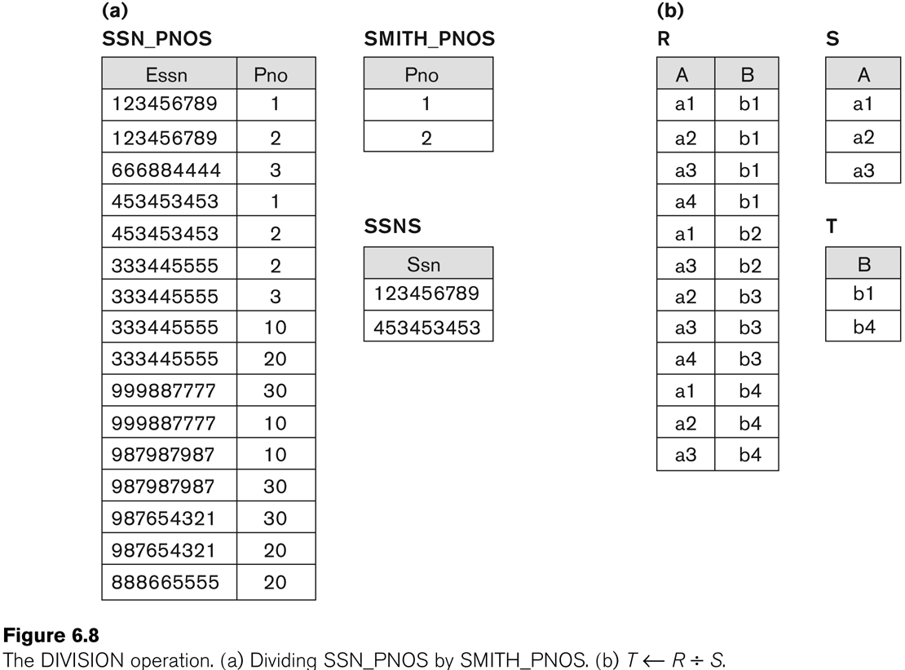
Example of DIVISION

Slide 52
Example of Division
Find the list of students who have submitted all database project.
Submission(Student,Task), Project(Id,Subject)
Student
S1
S3
Student | Task
S1 | DB-1
S1 | DB-2
S1 | CN-1
S2 | CN-2
S3 | DB-1
S2 | DB-2
S3 | DB-2
Id | Subject
DB-1 | Database
DB-2 | Database
CN-1 | Computer Network
CN-2 | Computer Network
ρ_{Work(Task)}[Π_{id}[σ_{subject=database}(Project)]]
Submission/Work

Slide 53
Outer Join
Left Outer Join
All the tuples from left hand side table and only the matching tuples from right hand side table.
Right Outer Join
All the tuples from right hand side table and only the matching tuples from left hand side table.
Full Outer Join
All the tuples from both the tables.

Slide 54
Sql Query
Left Outer Join
Select * from R left outer join S on C;
Right Outer Join
Select * from R right outer join S on C;
Full Outer Join
(Select * from R left outer join S on C) union (Select * from R right outer join S on C);

Slide 55
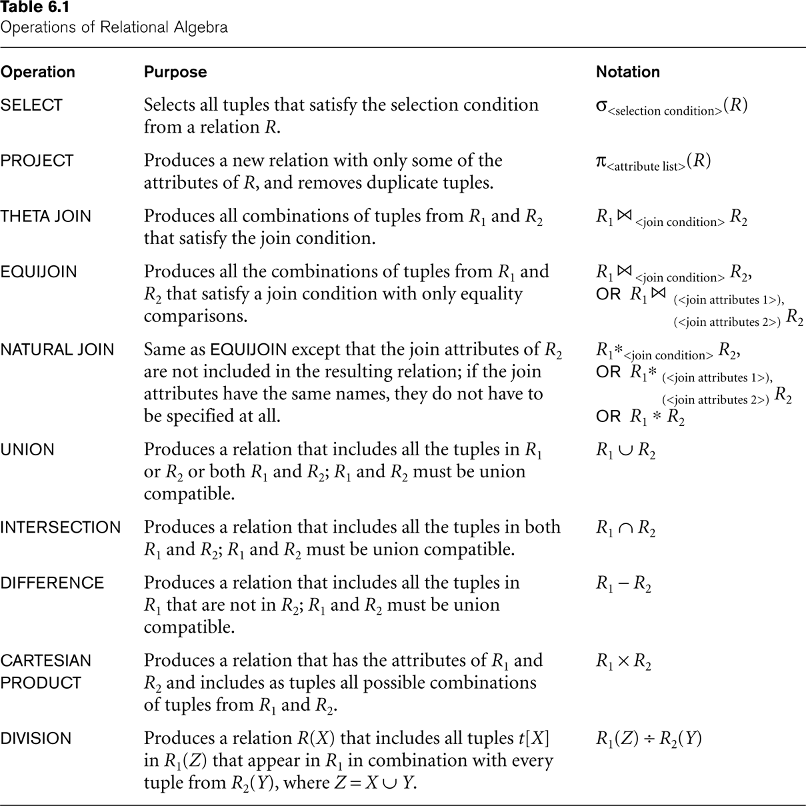
Recap of Relational Algebra Operations

Slide 56
Thanks

